Slide 1
IT tool training
Biocides Day
25th of October 2018
9:30-11:15 IUCLID
11:30-13:00 SPC Editor
14:00-16:00 R4BP 3

Slide 2
Biocides IT tools
To manage your data and prepare dossiers
To create and edit your SPC
To submit and manage your dossiers
SPC Editor
R4BP 3

Slide 3
IUCLID 6
Biocides Day
25th of October 2018
Dorota Burchard-Sosnowska
IUCLID Team
European Chemicals Agency

Slide 4
Agenda
IUCLID 6.3
New web user interface
Improvements related to the biocides
BPR dossier structure
IUCLID Demo
How to create a biocidal product family in IUCLID?
How the new user interface looks like?
Hands-on training (active substance generated in situ)
Launch IUCLID 6.3 and select the web user interface
Create a biocidal product dataset
Create biocidal product dossiers, and export them
Validate a biocidal product dataset, and correct an error

Slide 5
IUCLID 6.3

Slide 6
IUCLID 6.3
Released on 24th of October 2018
format changes
new web user interface
Biocides dossiers can be still submitted using any IUCLID 6 format
I6z files prepared in IUCLID 6.3 can be exported to previous major version, so 6.2

Slide 7
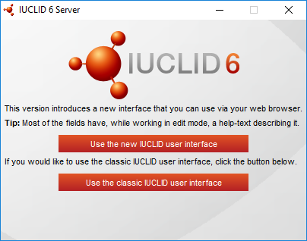
New web user interface
Requires only a standard web browser
Search any text on the screen (Ctrl + F)
Zoom in/out
Every document has an URL
More windows/tabs can be open at the same time
Page can be bookmarked
Gaps between the ‘classic’ user interface, and the new one continuously reducing
More information in the IUCLID demo

Slide 8
Microorganisms
New submission type for a substance: BPR Microorganisms (requirements of Annex II, title 2 of the BPR)
Dossier created based on:
BPR Active substance application (representative product)
BPR Biocidal product authorisation
substance dataset, section 2.1
No change for the dossier

Slide 9
Microorganisms… continued
New section (section 3 in BPR Microorganisms) dedicated to microorganisms
data required by section 3 Biological properties of the microorganism (Annex II, title 2)
data required by sections 5, 10 and 11 (Annex II, title 2) that cannot be reported elsewhere
data required by section 3.1 Biological properties of the microorganism in the biocidal product (Annex III, title 2)

Slide 10
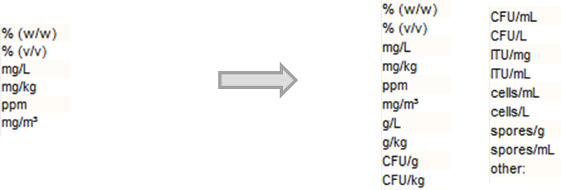
Microorganisms… continued
IUCLID picklists updated where…
IUCLID document could be used to report microorganisms data, but an existing picklist did not contain microorganisms related options, e.g. 4. Methods of detection and identification
Units specific for microorganisms were missing, e.g. 2.7 Content of the microorganism

Slide 11
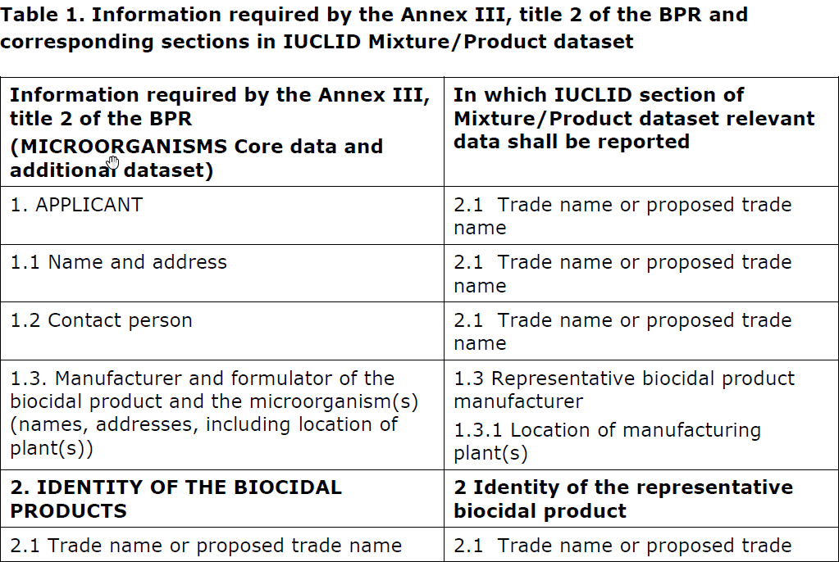
Microorganisms… continued
Annex 4 of the Biocides Submission Manual

Slide 12
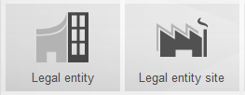
Legal entity site reported separately
‘Sites’ document added to the BPR submission types for substances and products
Legal entity site document now part of dossiers

Slide 13
Validation of BPR data
Two first validation rules are now available for BPR dossiers and datasets
Rules previously included at the dossier creation stage are now transferred to the Validation Assistant
BR001: The selected Biocidal Product dataset is not valid for creating BPR Biocidal product authorisation dossier. Valid Biocidal Product dataset for this dossier type must contain at least one component with function 'active substance' and a linked substance dataset. If there is more components with function 'active substance', a relevant substance or mixture dataset must be linked to each one.
BR002: The selected representative Biocidal Product dataset is not valid for creating BPR active substance application (representative product) dossier. Valid representative Biocidal Product dataset for this dossier type must contain exactly one component with function 'active substance' and a linked substance dataset for one representative product. If there is more than one representative product, the same active substance has to be linked in all records.

Slide 14
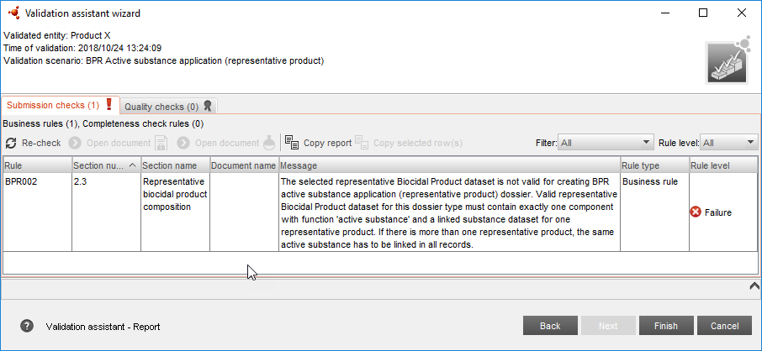
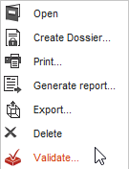
Validation in the classic user interface

Slide 15
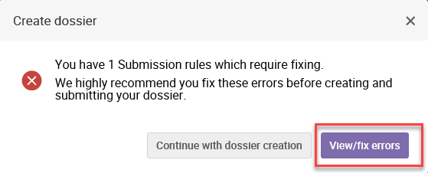
Validation in the web user interface

Slide 16
Biocidal product family
Reference fields that allow to indicate for which product(s) and/or meta SPC(s) the provided document is relevant
Products belonging to one family or meta SPC listed in the composition section of the meta SPC
Copying of summaries and records to build the family composition
More information in the DEMO

Slide 17
BPR dossiers

Slide 18
BPR dossier structure (substance-components only)
active substance
biocidal product
substances are linked in mixture / product section 2.3
reference substance are linked in substance section 2.1 and 2.9
BPR dossier is created based on a biocidal product dataset
other substance(s)

Slide 19
BPR dossier structure (including substance in mixture)
active substance in a mixture
mixture is linked in mixture / product section 2.3
reference substance is linked in substance section 2.1 and 2.9
substance is linked in mixture / product section 2.3
mixture
BPR Basic information (mixture)
biocidal product
BPR dossier is created based on a biocidal product dataset
substance is linked in mixture section 2.3
reference substance is linked in substance section 2.1 and 2.9
other substance(s)

Slide 20
Components of a BPR dossier
BPR Active substance information
BPR Microorganisms
BPR Basic information (substance)
BPR Substance of concern
Function: active substance
BPR Active substance application (representative product)
BPR Biocidal product authorisation
BPR Basic information (mixture)

Slide 21
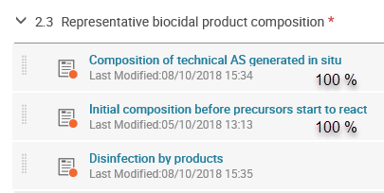
In situ generated active substance
Annex 2 to BSM updated on 1st of October

Slide 22
Reaction pathways described
substance composition (section 2.9)

Slide 23
More information

Slide 24
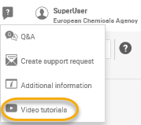
Help system
Help system integrated in IUCLID itself in both user interfaces
Handy links in the web user interface

Slide 25
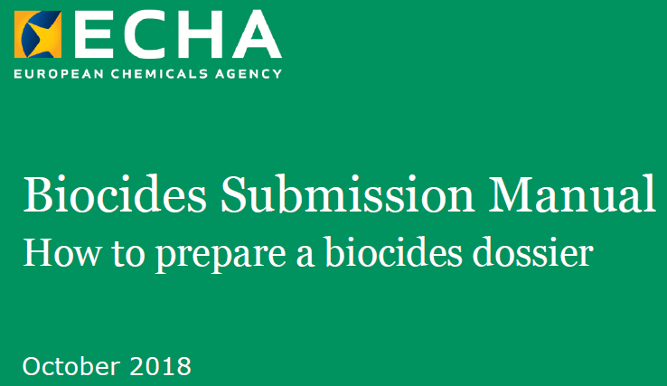
IUCLID manuals and webinars
https://iuclid6.echa.europa.eu/support
https://www.echa.europa.eu/web/guest/support
https://echa.europa.eu/support/dossier-submission-tools/r4bp/biocides-submission-manuals
25

Slide 26
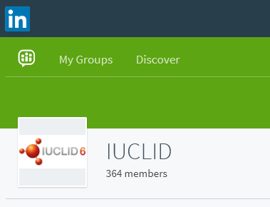
IUCLID LinkedIn group
iuclid6.echa.europa.eu
https://www.linkedin.com/groups/12043483
26

Slide 27
Thank you!
Contact:
dorota.burchard-sosnowska@echa.europa.eu
Subscribe to our news at: echa.europa.eu/subscribe
Follow us on:
Twitter
YouTube
Facebook
LinkedIn
Wikipedia

Slide 28
Demo
How to create a biocidal product family in IUCLID?
How the new web user interface looks like?

Slide 29
Hands on training
Creation and update of a IUCLID dossier using the web user interface

Slide 30
Scenario
PART 1: Launch IUCLID 6 and select the web user interface to be used
PART 2: Create a biocidal product dataset
PART 3: Create a BPR Active substance application (representative product) dossier and a BPR Biocidal product authorisation dossier, and export them
PART 4: Correct an error in a product dataset in order to successfully create a BPR dossier (validation)

Slide 31
Feedback
Your feedback is important for us
Feedback survey made available today
Programme continues
11:30-13:00 SPC Editor
14:00-16:00 R4BP 3

