Slide 1
IUCLID 6
IUCLID for biocides
Vienna
4 December 2017
Dorota Burchard-Sosnowska
IUCLID Team
European Chemicals Agency

Slide 2
Agenda
Introduction
IUCLID installation (reminder)
BPR dossiers
Report generator
Improvements in IUCLID 6.2
IUCLID Cloud
Plans for the future
Where to find further information
Hands-on training

Slide 3
Introduction

Slide 4
Biocides IT tools
To manage your data and prepare dossiers
To create and edit your SPC
To submit and manage your dossiers
SPC Editor
R4BP 3

Slide 5
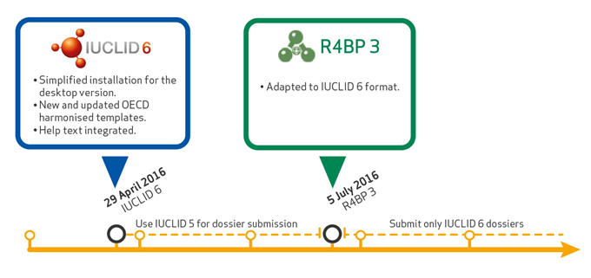
IUCLID 6 and R4BP3

Slide 6
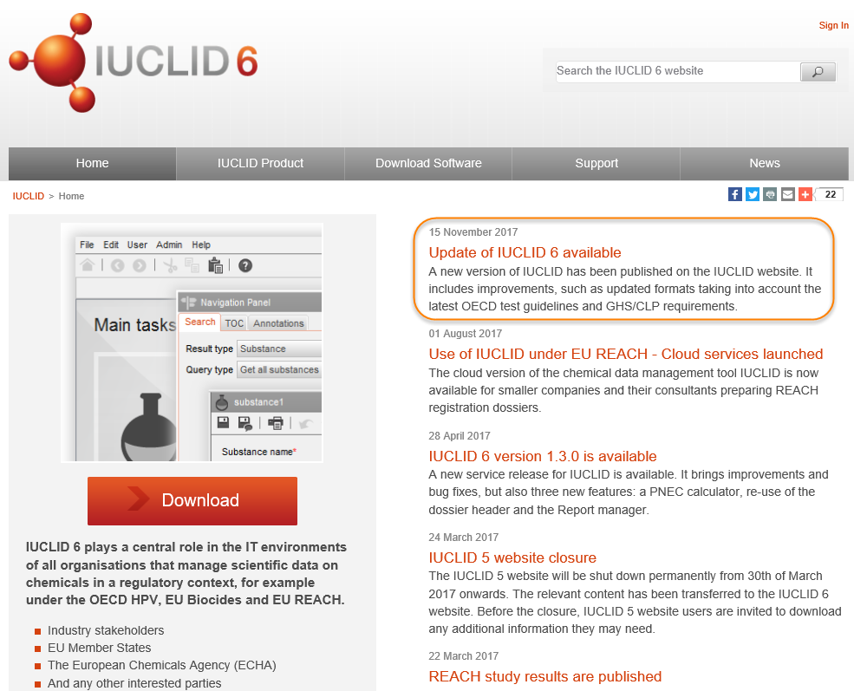
IUCLID 6 website
iuclid6.echa.europa.eu

Slide 7
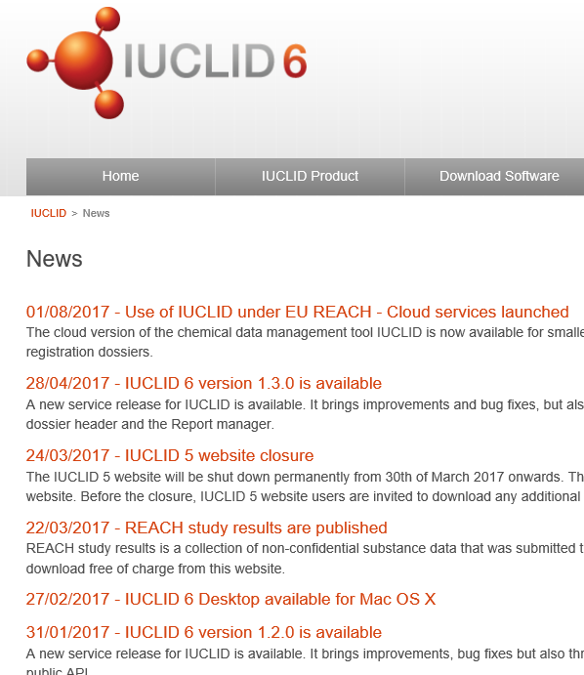
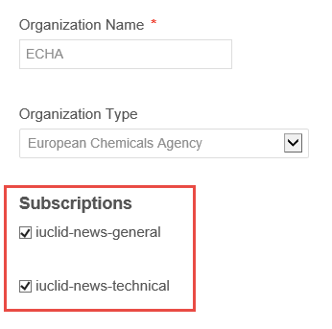
IUCLID 6 website
News
My account

Slide 8
IUCLID installation

Slide 9
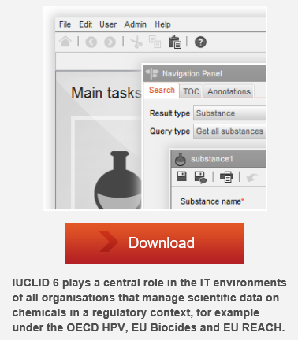
IUCLID 6 desktop version
Installer contains all the elements needed to run IUCLID
Installation in a few clicks
Migration of your IUCLID 5 data
Desktop version + one user = you don’t need to log in
Video tutorial available:
https://www.youtube.com/watch?v=jeZ-v6qoeds

Slide 10
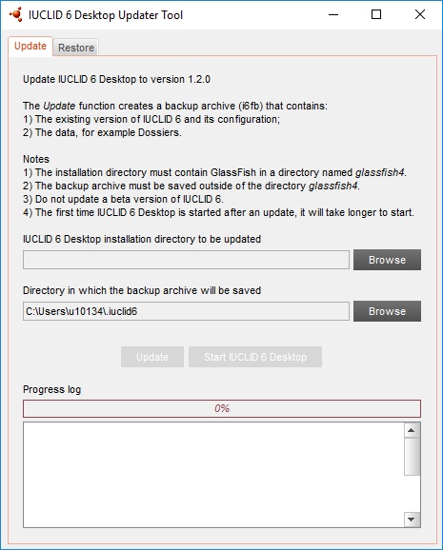
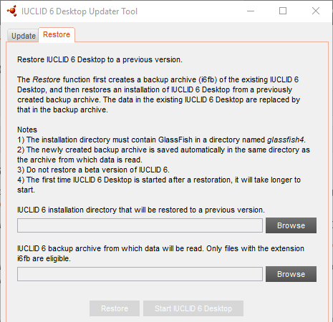
IUCLID 6 updater
If you already have IUCLID 6 you can update to the latest available version
Update function
Restore function
Video tutorial available:
https://www.youtube.com/watch?v=attg0gSc-AM

Slide 11
Extension of the compatibility between IUCLID versions
Aim: export of .i6z files from IUCLID 6.2 that can be loaded in IUCLID 6.1
Backward migration rules have been defined

Slide 12
BPR dossiers

Slide 13
Starting point for each submission type
Representative biocidal product:
Biocidal product
to be authorised:
one active substance
one or more active substances
other substances and mixtures

Slide 14
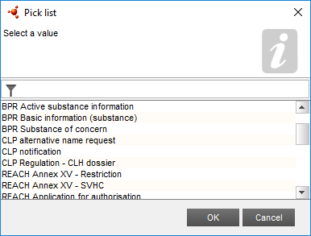
Preparing a substance dataset (BP component)
BPR Active substance information
BPR Substance of concern
BPR Basic information (substance)
2.9 Composition of the substance
Specification on purity of the active substance as manufactured
Composition of the substance of concern
Composition of the substance

Slide 15
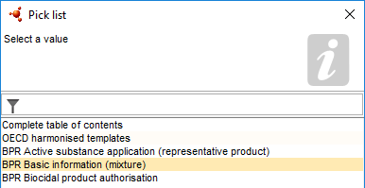
Preparing a mixture / product dataset (BP component)
BPR Basic information (mixture)
2.3 Composition of the mixtures
Mixture composition

Slide 16
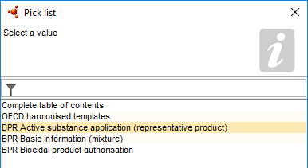
Preparing a biocidal product dataset
BPR Active substance application (representative product)
BPR Biocidal product authorisation
2.3 Composition of the mixtures
Biocidal product composition
Representative biocidal product composition

Slide 17
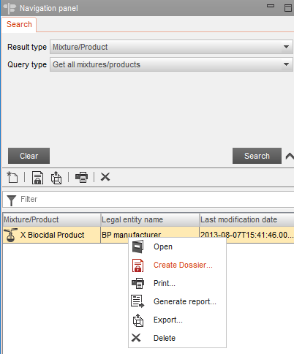
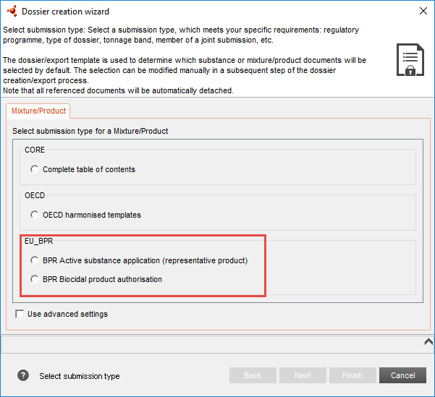
Dossier creation

Slide 18
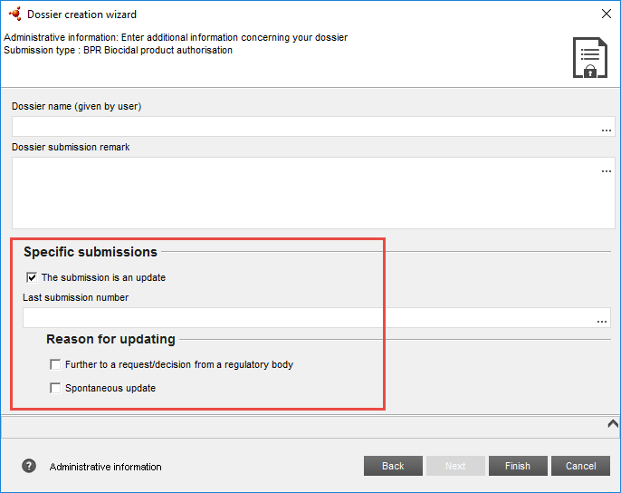
Dossier update

Slide 19
Worth to remember (1)
BPR Active substance application (representative product)
Only one active substance allowed
Function ‘active substance’ indicated
Substance linked (not a reference substance)
Only record allowed

Slide 20
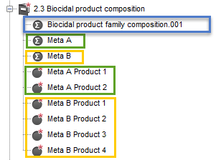
Worth to remember (2)
Biocidal product family
Meta
Biocidal product (family member)
Intended uses specified in section 7.1
Classification & Labelling specified in section 12.1, 12.2
Packaging specified in section 12.3
linked to a single product

Slide 21
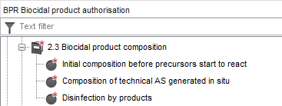
In situ generated active substance: all components reported
NEW Annex 2 to BSM coming soon

Slide 22
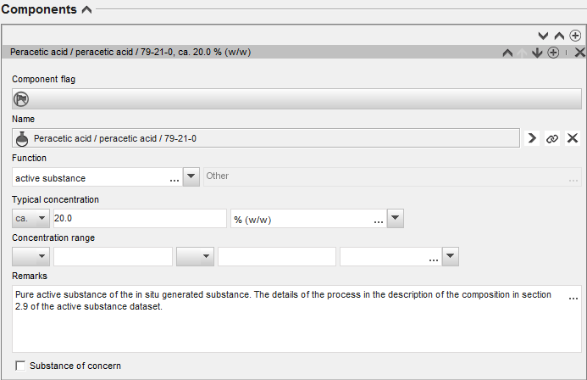
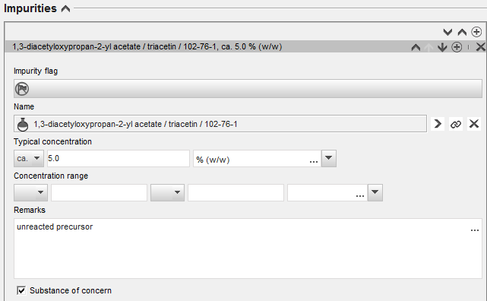
In situ generated active substance: all concentrations reported

Slide 23
In situ generated active substance: all reaction pathways described
substance
mixture

Slide 24
Filtering the content of a dossier
24

Slide 25
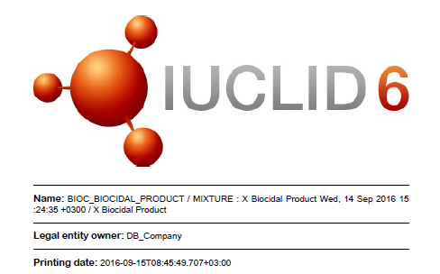
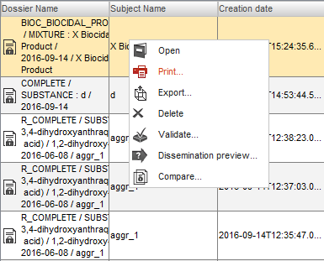
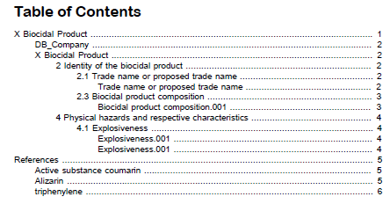
Printing a dossier

Slide 26
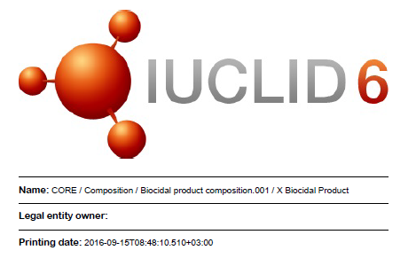
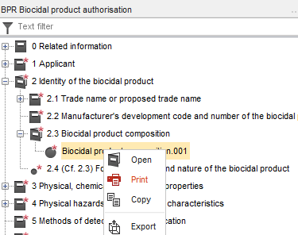
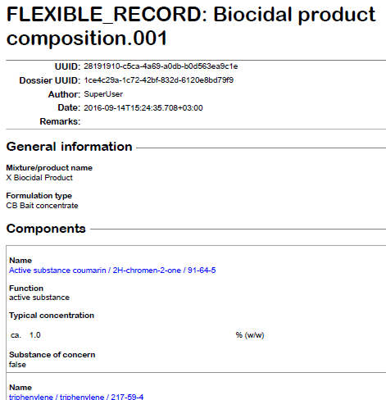
Printing an endpoint

Slide 27
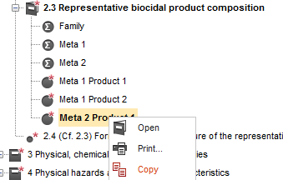
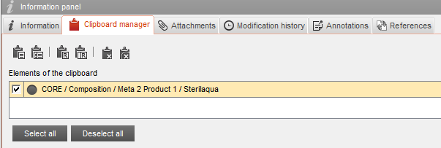
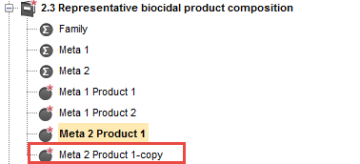
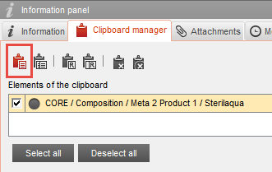
Copying a IUCLID document

Slide 28
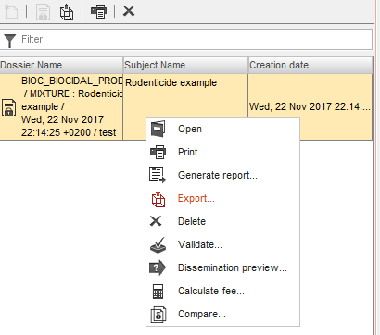
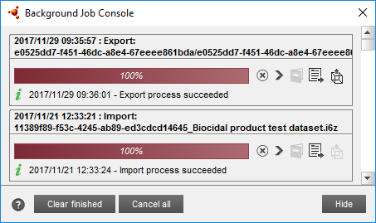
Exporting a dataset / dossier

Slide 29
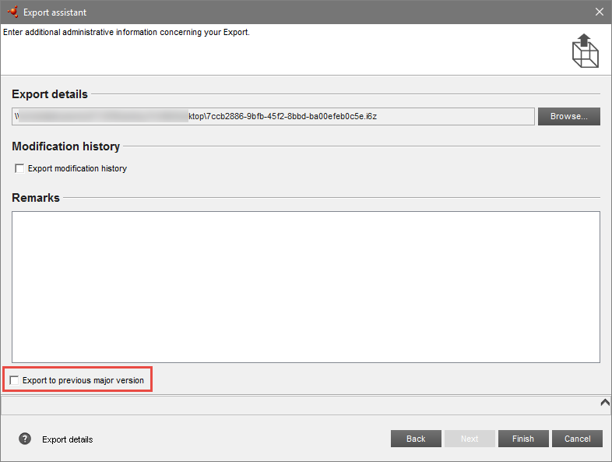
Export in the previous version format
An option to export to the previous IUCLID 6 format ‘Export to previous major version’
available for datasets and dossiers
available for bulk export
you can use this option when you need to exchange information with a user who is still using IUCLID 6 version 1.x
video tutorial coming soon
EUchemicals

Slide 30
Embedded help system
Help system integrated in IUCLID itself
Dossier Submission Manuals included
Including the Biocides Submission Manual: how to use IUCLID under BPR

Slide 31
Annotations
Industry prepares the datasets for the substances, mixtures and biocidal product – editable
Industry prepares the dossier to be submitted via R4BP to the ECHA database which can be accessed by MSCA – read only
MSCA reviews the dossier and comments on it using the annotations that will be sent to Industry – editable
Industry receives the annotations from MSCA and based on them corrects the information in the datasets and creates new dossier to be sent to ECHA
31

Slide 32
Why annotations?
All comments and assessment related to one substance/product in one place
Easy dialogue with the Applicant
Possibility to share experience with other Competent Authorities
Annotations exported from IUCLID are in .i6z format. You need to change their formats to .7z or .zip files, accepted by R4BP 3.
32

Slide 33
Report generator

Slide 34
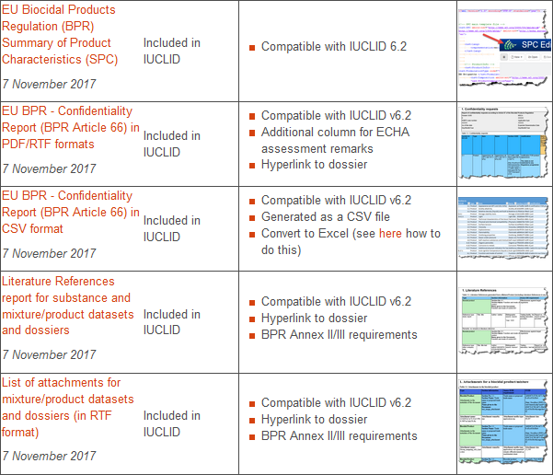
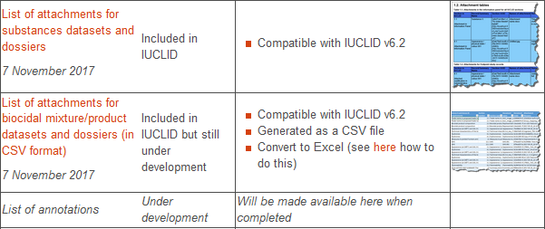
IUCLID Report generator
iuclid6.echa.europa.eu/reports

Slide 35
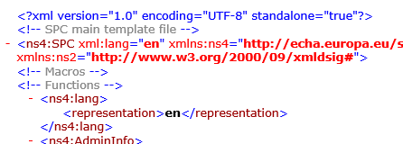
Summary of product characteristics (SPC) report (1)
Main purpose: extraction of the IUCLID data that are relevant for the Summary of Product Characteristics (SPC)
Relevant for a single biocidal product
Generates an XML file compatible with the SPC Editor

Slide 36
Summary of product characteristics (SPC) report (2)
The generated file contains the following information:
Identity of the biocidal product
Product type, formulation type
Product composition
Authorized uses
Directions for use
Packaging
Measures to protect humans, animals and the environment
Labelling information
Some administrative information

Slide 37
Literature References Report
Main purpose: extraction of all literature references included in a dossier (in all its components)
Relevant for datasets and both types of BPR dossiers
Generates an RTF file
Gives a reference to IUCLID section number and name, and to BPR Annex II/III requirements
Hyperlink included (IUCLID Production, server)

Slide 38
BPR – Confidentiality Report (BPR Article 66)
Main purpose: extraction of all confidentiality claims from a dossier, so MSCA could decide on whether these claims can be accepted or not
Relevant for both types of BPR dossiers
Available file formats: RTF, PDF, CSV (easily conversion to xls)
Completed assessment can be sent to ECHA via the R4BP messaging system https://idp-authority.echa.europa.eu/idp/
Hyperlink included (IUCLID Production, server)

Slide 39
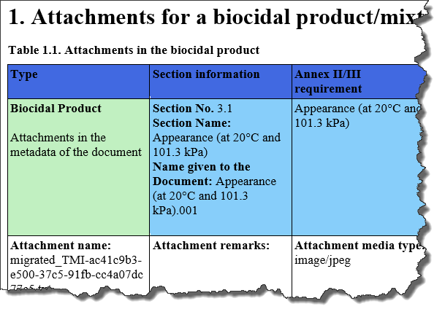
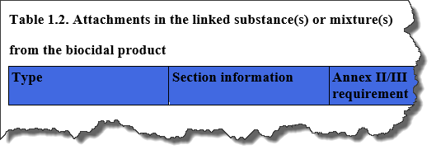
List of attachments for BPR datasets and dossiers
Main purpose: listing of all attachments included in a dossier (in all its components)
Relevant for datasets and both types of BPR dossiers
Available file formats: RTF, CSV (easily conversion to xls)
Gives a reference to IUCLID section number and name, and to BPR Annex II/III requirements
Hyperlink included (IUCLID Production, server)

Slide 40
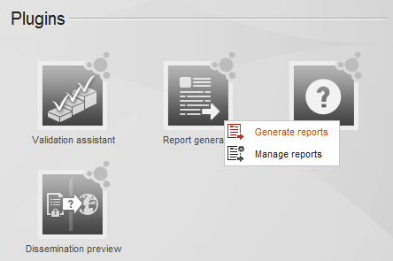
How to generate report
starting from IUCLID home page (1)

Slide 41
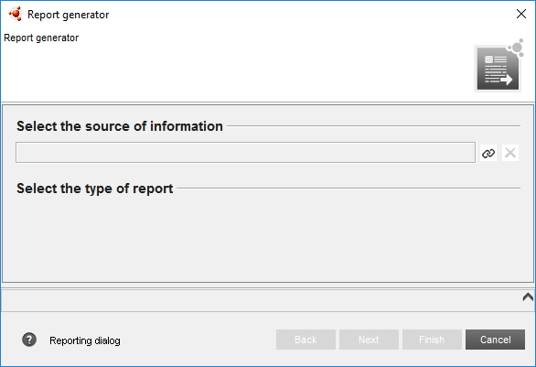
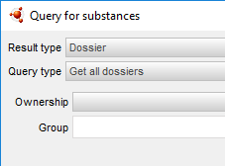
How to generate report
starting from IUCLID home page (2)

Slide 42
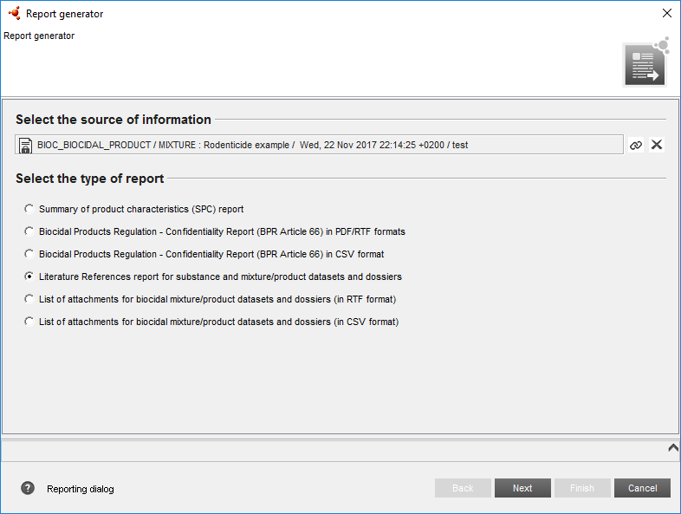
How to generate report
starting from IUCLID home page (3)

Slide 43
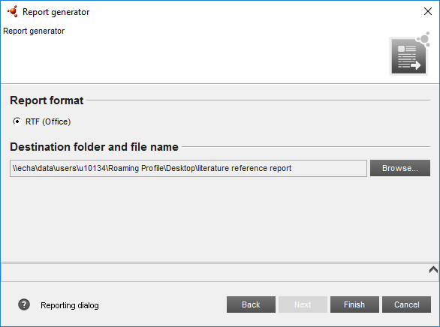
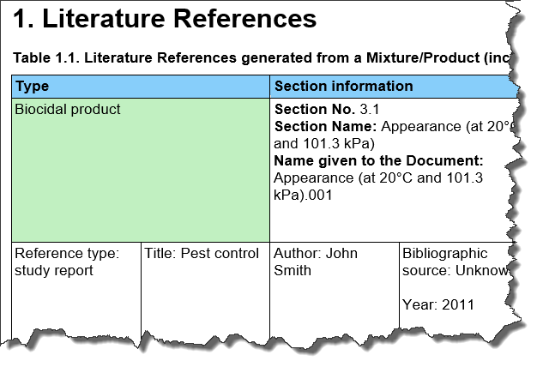
How to generate report
starting from IUCLID home page (4)

Slide 44
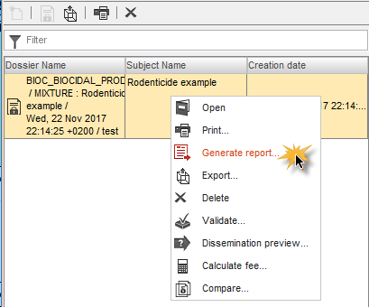
How to generate a report
starting from a dataset or dossier
Select a biocidal product dataset or dossier in the Navigation Panel and click ‘Generate report…’

Slide 45
IUCLID Report generator
Create your own reports
iuclid6.echa.europa.eu/reports

Slide 46
Improvements in IUCLID 6.2

Slide 47
Split of the IUCLID flags
Make the data protection association of Document fields to confidentiality fields explicit, instead of currently being implicit
Each document element (field, block, or even the document itself) is explicitly linked to the confidentiality fields
The data protection information is following these rules:
the first field of a document is protecting the document
otherwise the first field of a block is protecting the block
otherwise the confidentiality field protects the direct following field
otherwise there is no data protection

Slide 48
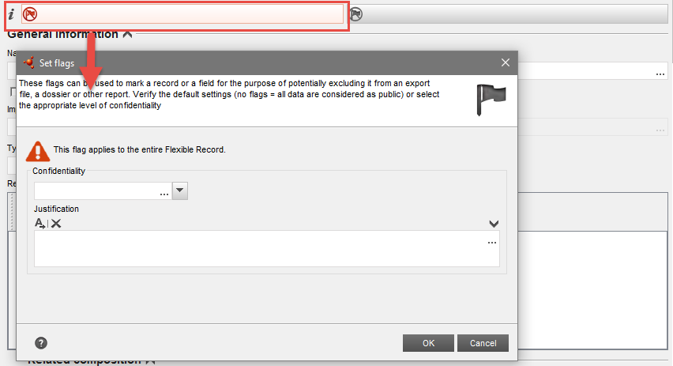
Split of the IUCLID flags

Slide 49
Split of the IUCLID flags

Slide 50
Print option
New option added to print a record or a dataset without the fields marked confidential in IUCLID

Slide 51
Method of application
The same updated pick list in sections:
6.1 Function and mode of control
7.6 Method of application and description of this method
Remarks field

Slide 52
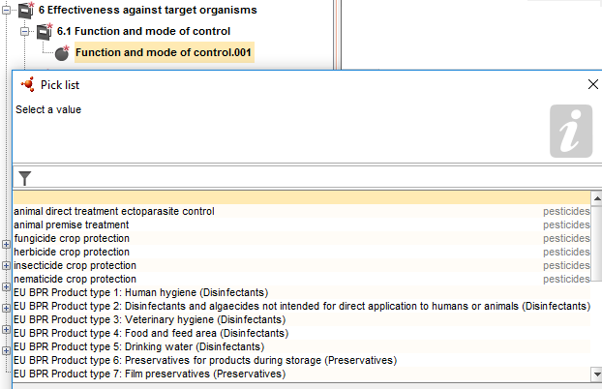
Product type in section 6.1
Product type pick list in 6.1 (Function and mode of control) adapted to the requirements of the BPR
Relevant also for pesticides

Slide 53
Material of packaging
The only option related to all kinds of plastic is now ‘plastic’ with an additional field for specify

Slide 54
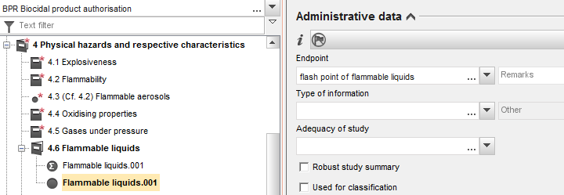
Flammable liquids
Flammable liquids in section 4.6 with an own template (in the past it was a reference section)

Slide 55
Terrestrial toxicity, initial tests
Endpoint summary available in all submission types:
9.2 – all substances
9.2.2 – biocidal product, representative product
9.1.2 – basic information (mixture)

Slide 56
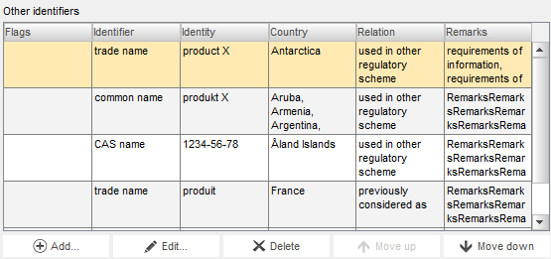
Readability of tables
The height of the tables increased so that the minimum number of rows displayed increases to four even when each row is taking three lines.

Slide 57
IUCLID Cloud

Slide 58
IUCLID Cloud
Two services
IUCLID Cloud for SMEs: aimed for SMEs, and their consultants, to prepare registration dossiers for REACH 2018 deadline
IUCLID Trial: available for everybody to try the service and to use as a training environment
Access using your ECHA account
After the 2018 registration deadline ECHA will assess the use and the cost of the Cloud and assess whether to extend the services to other user groups

Slide 59
Always work on the latest version of the application
Benefits
Data is more secure because of reduced number of local copies
Reduced risks of data loss (backups managed by ECHA)
No cost for users managing installations and hardware
Facilitate working anywhere (easier remote access) and delegation to consultants
Possibilities for better online support

Slide 60
Plans for the future

Slide 61
Improvements (under analysis)
Microorganisms
additional section dedicated to microorganisms
reuse of some existing BPR endpoints for microorganisms (added options in the endpoint picklists)
“translation” document or a help text
Test materials relevant for a biocidal product
Possibility to link a biocidal product composition (currently reference substance)
Update of picklists:
‘Formulation type’ in sections 2.3 and 6.7
‘Type of method’ in section 3.5

Slide 62
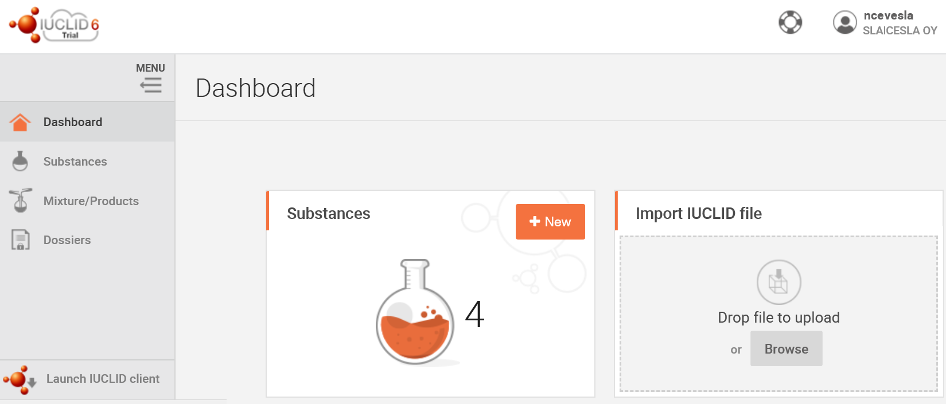
IUCLID 6 web interface
Support functionalities
Create new substances
Import IUCLID data

Slide 63
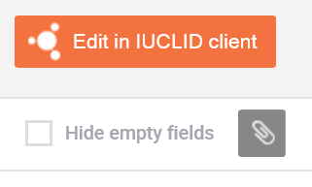
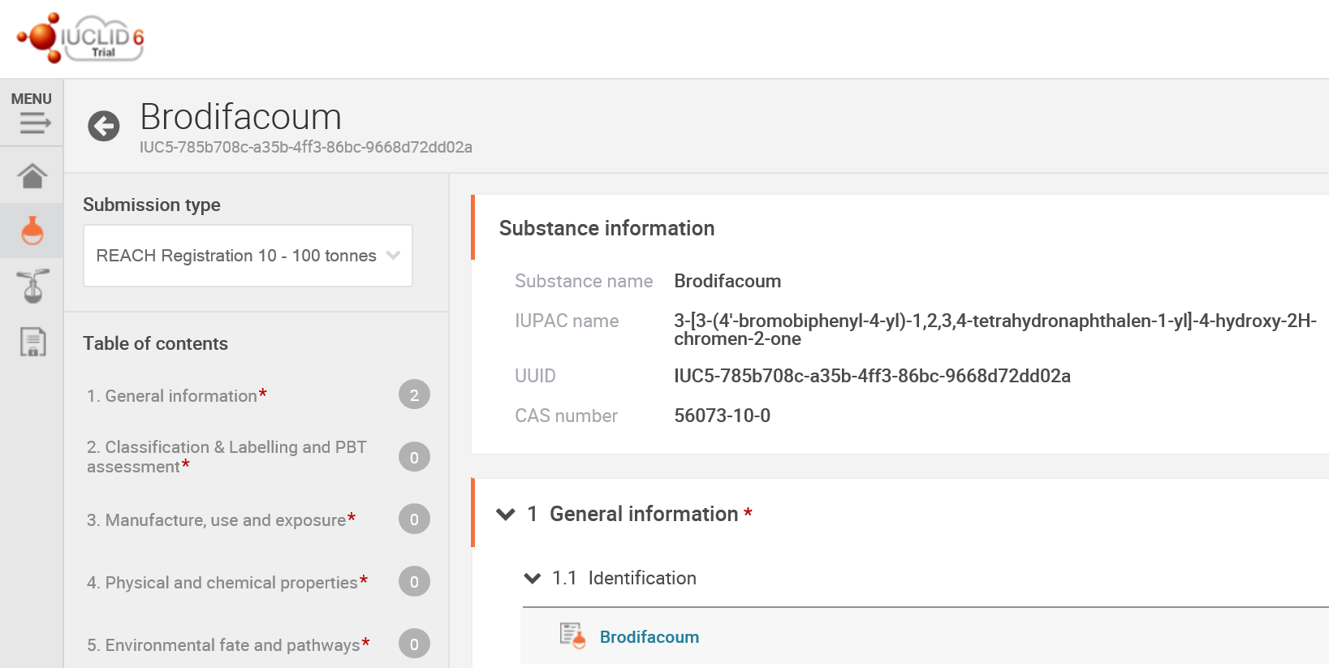
IUCLID 6 web interface
Open the document for editing
Collapsible menu
Access to additional information and attachments
IUCLID Tree view and shortcuts to all sections

Slide 64
Where to find further information

Slide 65
IUCLID manuals and webinars
https://iuclid6.echa.europa.eu/support
https://www.echa.europa.eu/web/guest/support
65

Slide 66
IUCLID LinkedIn group
https://www.linkedin.com/groups/12043483
Platform to exchange, discuss and provide feedback on the use of IUCLID and on future evolutions of the product
Join now to be involved in the development of our database
iuclid6.echa.europa.eu/home
66

Slide 67
Thank you!
Contact:
dorota.burchard-sosnowska@echa.europa.eu

Slide 68
Hands on training
IUCLID 6 for biocides

Slide 69
Scenario
PART 1: Launch IUCLID 6
PART 2: Import a biocidal product dataset
PART 3: Create a biocidal product authorisation dossier
PART 4: Edit the product dataset and update the dossier
PART 5: Generate reports based on IUCLID data
Preconditions:
IUCLID 6 installed (1.3.0 or 2.0.0)
Files downloaded

