Slide 1
IUCLID 6
Biocides Stakeholders’ Day
27 September 2017
Dorota Burchard-Sosnowska
IUCLID Team
European Chemicals Agency

Slide 2
Agenda
Introduction
IUCLID installation
IUCLID updater
BPR dossiers
Report generator
Where to find further information
Hands-on training

Slide 3
Introduction

Slide 4
Biocides IT tools
To manage your data and prepare dossiers
To create and edit your SPC
To submit and manage your dossiers
SPC Editor
R4BP 3

Slide 5
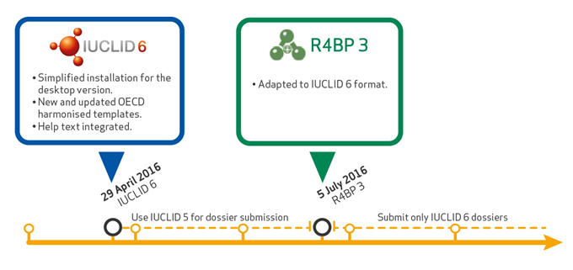
IUCLID 6 and R4BP3

Slide 6
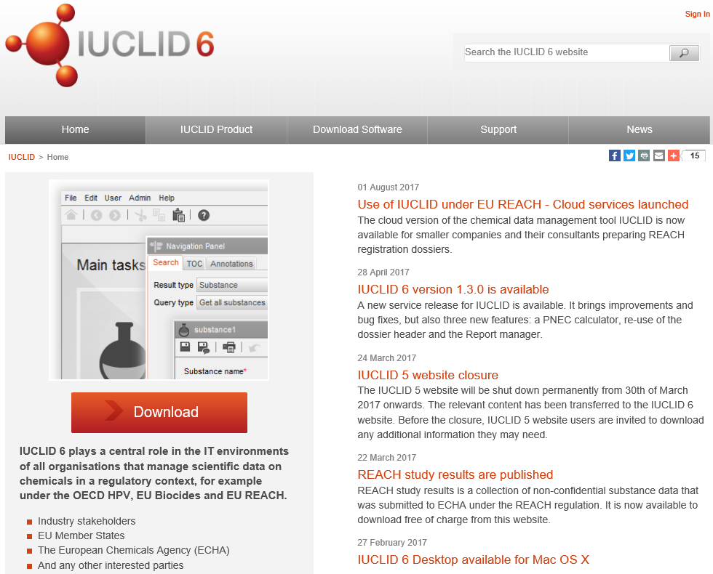
IUCLID 6 website
iuclid6.echa.europa.eu

Slide 7
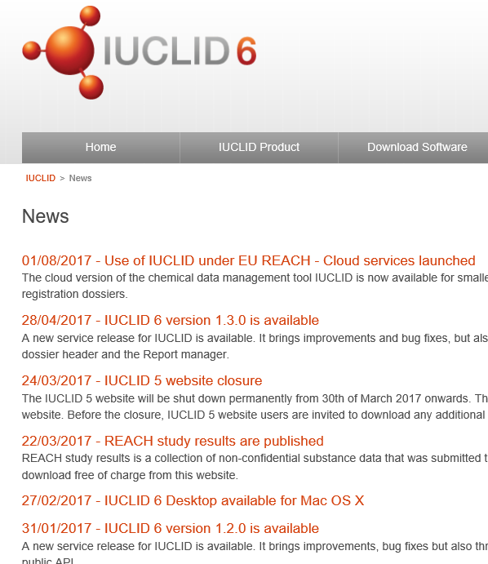
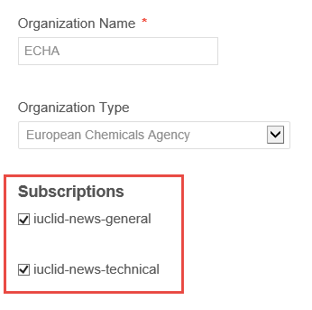
IUCLID 6 website
News
My account

Slide 8
Planned releases
Information on the planned IUCLID 6 releases can be found on the IUCLID 6 website
https://iuclid6.echa.europa.eu/project-iuclid-6#ServiceRelease

Slide 9
IUCLID installation

Slide 10
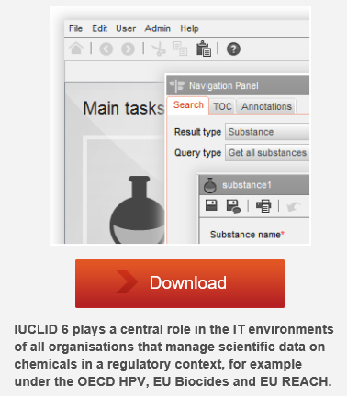
IUCLID 6 desktop version
Installer contains all the elements needed to run IUCLID
Installation in a few clicks
Migration of your IUCLID 5 data
Desktop version + one user = you don’t need to log in
Video tutorials available: https://www.youtube.com/playlist?list=PLOPGDACSd6qyDkdXwPua1Fjb5bJksY75k

Slide 11
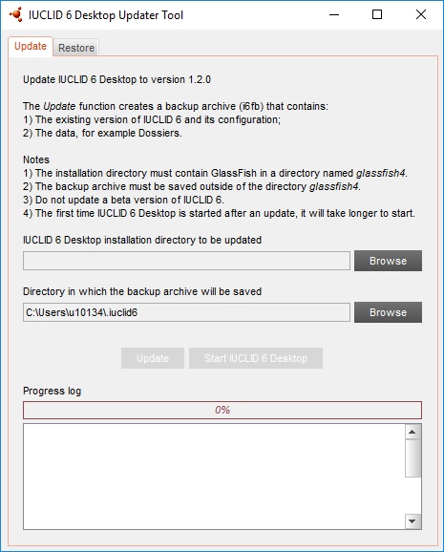
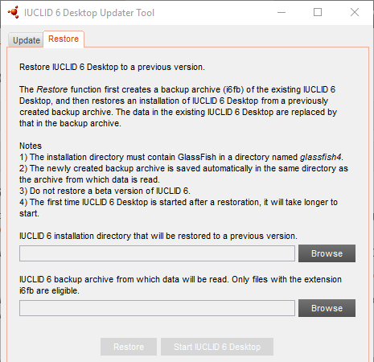
IUCLID 6 updater
If you already have IUCLID 6 you can update to the latest available version
Update function
Restore function
Video tutorials available: https://www.youtube.com/playlist?list=PLOPGDACSd6qyDkdXwPua1Fjb5bJksY75k

Slide 12
BPR dossiers

Slide 13
Starting point for each submission type
Representative biocidal product:
Biocidal product
to be authorised:
one active substance
one or more active substances
other substances and mixtures

Slide 14
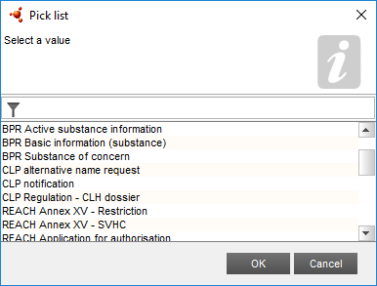
Preparing a substance dataset (BP component)
BPR Active substance information
BPR Substance of concern
BPR Basic information (substance)
2.9 Composition of the substance
Specification on purity of the active substance as manufactured
Composition of the substance of concern
Composition of the substance

Slide 15
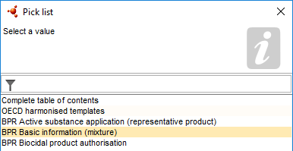
Preparing a mixture / product dataset (BP component)
BPR Basic information (mixture)
2.3 Composition of the mixtures
Mixture composition

Slide 16
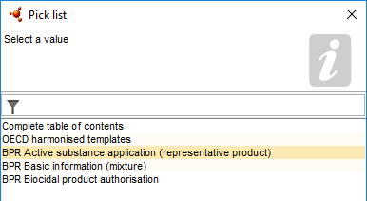
Preparing a biocidal product dataset
BPR Active substance application (representative product)
BPR Biocidal product authorisation
2.3 Composition of the mixtures
Biocidal product composition
Representative biocidal product composition

Slide 17
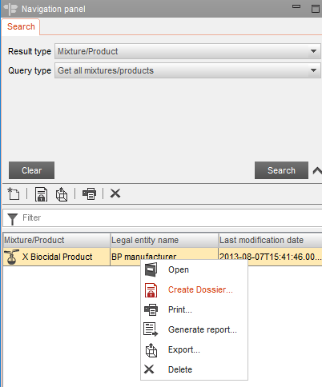
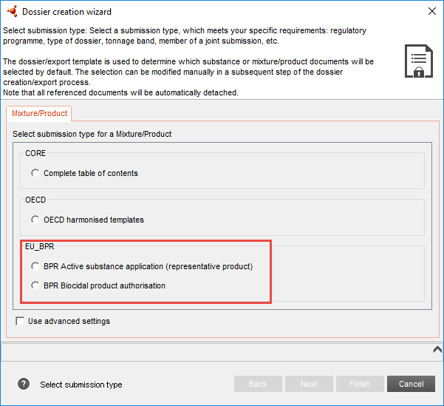
Dossier creation

Slide 18
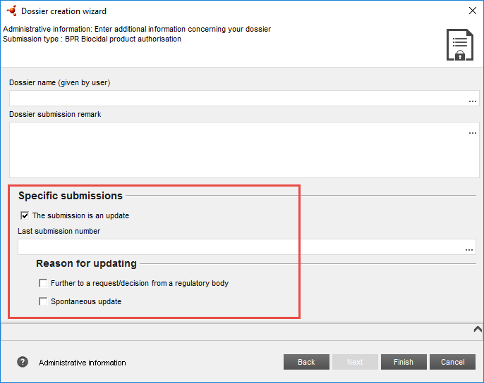
Dossier update

Slide 19
Worth to remember (1)
BPR Active substance application (representative product)
Only one active substance allowed
Function ‘active substance’ indicated
Substance linked (not a reference substance)
Only record allowed

Slide 20
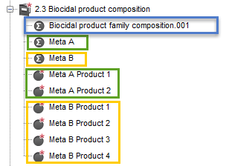
Worth to remember (2)
Biocidal product family
Meta
Biocidal product (family member)
Intended uses specified in section 7.1
Classification & Labelling specified in section 12.1, 12.2
Packaging specified in section 12.3
linked to a single product

Slide 21
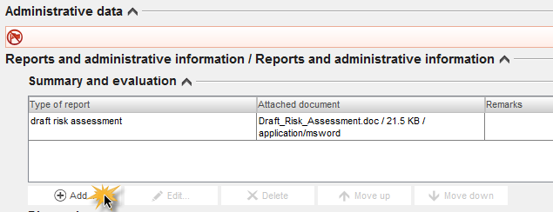
Worth to remember (3)
Risk assessment report
section 13

Slide 22
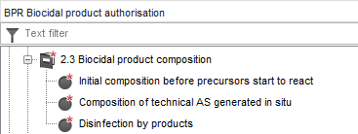
In situ generated active substance
NEW Annex 2 to BSM coming soon

Slide 23
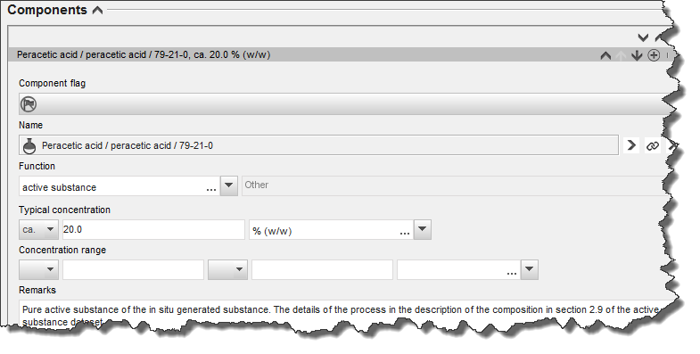
In situ generated active substance
NEW Annex 2 to BSM coming soon

Slide 24
Filtering the content of a dossier
24

Slide 25
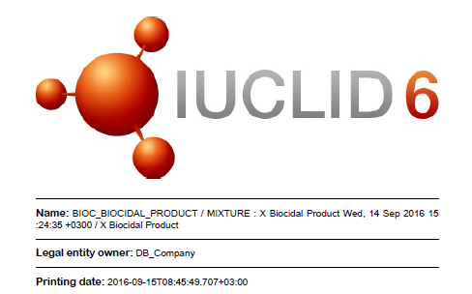
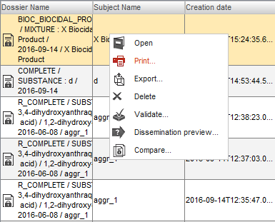
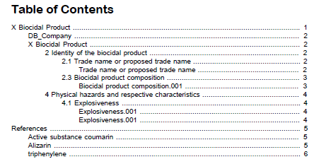
Printing a dossier

Slide 26
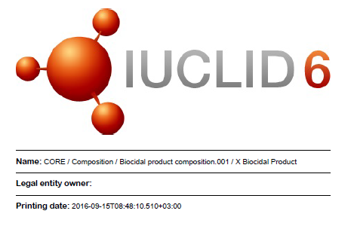
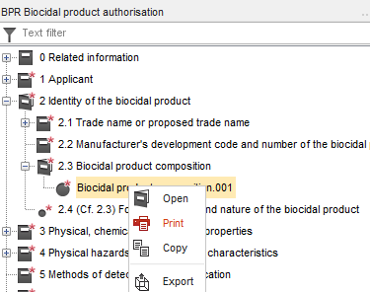
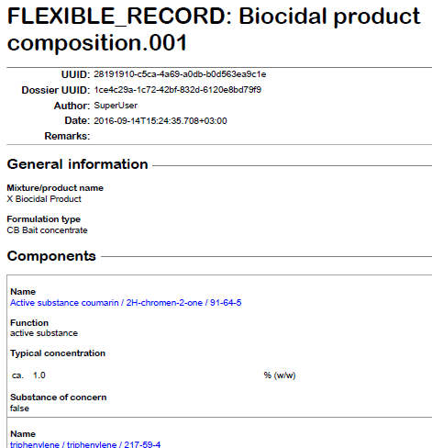
Printing an endpoint

Slide 27
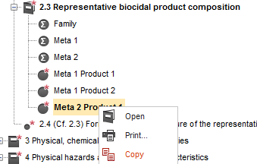
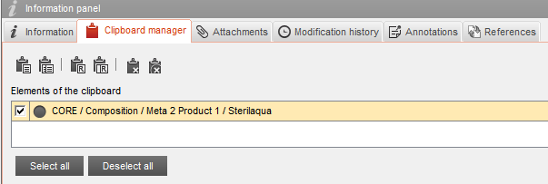
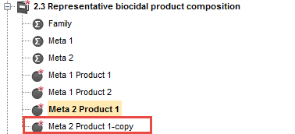
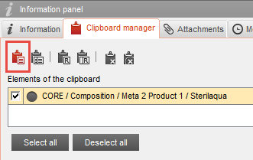
Copying a IUCLID document

Slide 28
Embedded help system
Help system integrated in IUCLID itself
Dossier Submission Manuals included
Including the Biocides Submission Manual: how to use IUCLID under BPR

Slide 29
Report generator
Summary of product characteristics

Slide 30
IUCLID Report generator - SPC
Main purpose: extraction of the IUCLID data that are relevant for the Summary of Product Characteristics (SPC)
Relevant for a single biocidal product
Generates an XML file compatible with the SPC Editor

Slide 31
IUCLID Report generator - SPC
The generated file contains the following information:
Identity of the biocidal product
Product type, formulation type
Product composition
Authorized uses
Directions for use
Packaging
Measures to protect humans, animals and the environment
Classification and Labelling information
Some administrative information

Slide 32
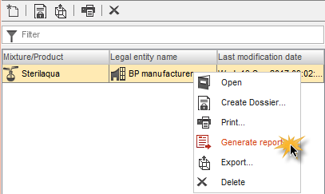
How to generate a report
Select a biocidal product dataset or dossier in the Navigation Panel and click ‘Generate report…’

Slide 33
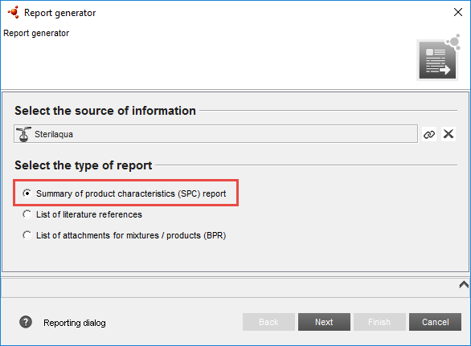
How to generate a report

Slide 34
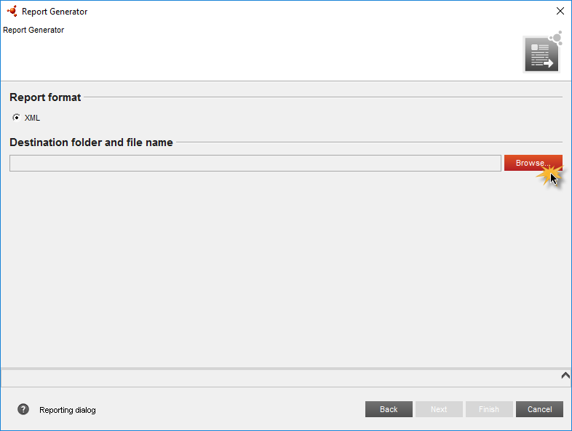
How to generate a report
Select a destination folder to store your report as an XML file

Slide 35
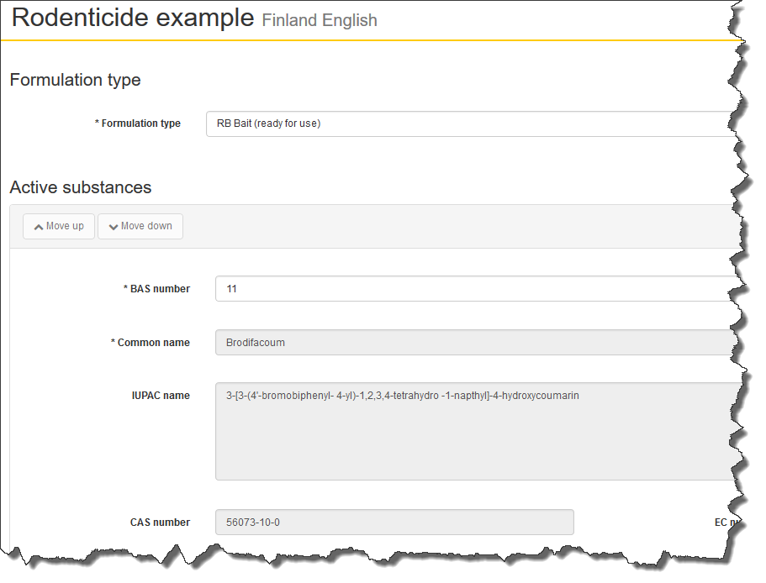
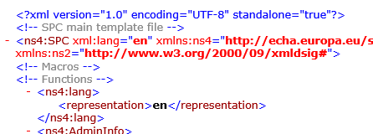
How to generate a report
Import the XML file in the SPC Editor as a starting point for creating your SPC for a single product

Slide 36
IUCLID Report generator
More report templates
List of confidentiality claims in BPR dossiers
List of literature references included in a dossier
List of attachments
More information:
https://iuclid6.echa.europa.eu/reports

Slide 37
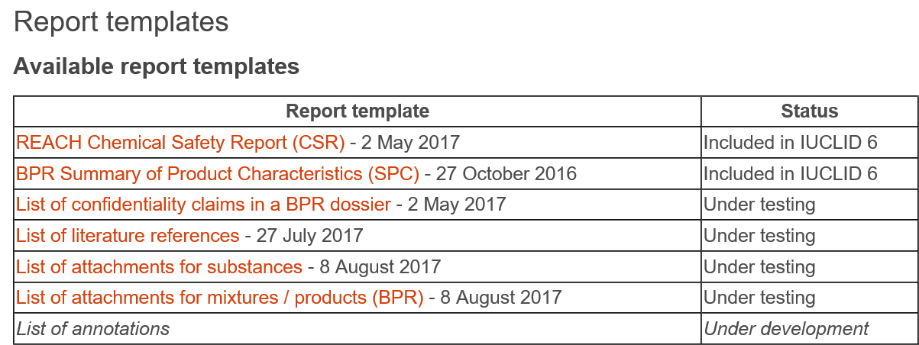
IUCLID Report Generator
You can download the report templates from ECHA’s IUCLID website
iuclid6.echa.europa.eu/reports

Slide 38
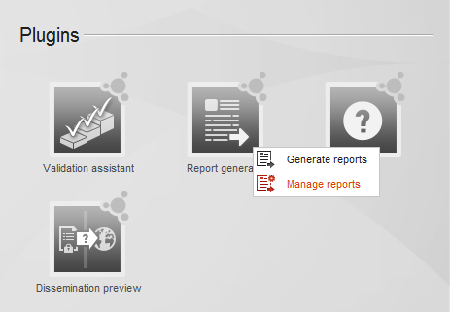
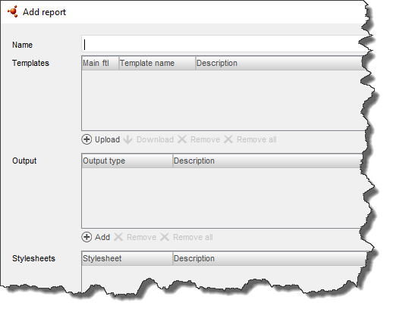
IUCLID Report Generator
You can add and manage the report templates in IUCLID, and then generate different reports based on a dataset or a dossier

Slide 39
IUCLID Report generator
Create your own reports
iuclid6.echa.europa.eu/reports

Slide 40
Where to find further information

Slide 41
IUCLID manuals and webinars
https://iuclid6.echa.europa.eu/support
https://www.echa.europa.eu/web/guest/support
41

Slide 42
Thank you!
Contact:
dorota.burchard-sosnowska@echa.europa.eu
Subscribe to our news at: echa.europa.eu/subscribe
Follow us on:
Twitter
YouTube
Facebook
LinkedIn
Wikipedia

Slide 43
Hands on training
IUCLID 6 for biocides

Slide 44
Scenario
PART 1: Launch IUCLID 6
PART 2: Create a biocidal product authorisation dossier
PART 3: Edit the product dataset
How to create and rename a IUCLID document
How to update a dossier
How to copy a IUCLID document (optional exercise)
PART 4: Generate an SPC XML file
How to generate a list of literature references (optional exercise)
How to generate a list of attachments (optional exercise)

