Slide 2
Test phase 6 / 5 February 2016
IUCLID 6 testing

Slide 3
⬥ IUCLID 6 schedule  Content of the test version  Good to know before starting the migration from IUCLID 5.6 to IUCLID 6  Feedback and issues reporting  IUCLID 6 format changes  IUCLID 6 features
Content

Slide 4
IUCLID 6 schedule

Slide 5
IUCLID 6 schedule
2014
Q2 2015
End. Apr. 2016
IUCLID 6 project starts
IT Architecture review
New functions
IUCLID 6 beta version
OECD Harmonised Templates
REACH, BPR and CLP
IUCLID 6 official release
Progressive maintenance
…

Slide 6
IUCLID 6 beta version (June 2015)
Technical upgrade
New architecture
New data model
Renewal of all IT components
Alignment of the data structure
Section 1-3 aligned with the rest of the sections (records can be created)
IUCLID document types redefined
Flexible records, flexible summaries
Fixed records…
Data types redefined
IUCLID documents ‘harmonised’
Use of inherited templates streamlined
Additional functions (e.g. security, user management)

Slide 7
IUCLID 6 official release (end Apr. 2016)
Scope overview
IUCLID format update
Update of the OECD Harmonised Templates
Use and exposure information harmonisation
Assessment entity
Substance identity
Etc.
Simplification
Help system
Simplification of user interface and key functions
Installation of Desktop version
Support for REACH-IT online dossiers
IUCLID 6 configuration, development of IUCLID plug-ins
Validation Assistant
Filtering, Aggregation
Report generator

Slide 8
Content of the test version

Slide 9
Scope of test phase 6
Document format
Migration from IUCLID 5.6 to IUCLID 6 (during import and database-to-database)
Validation assistant
Help system (IUCLID functionalities – F1)

Slide 10
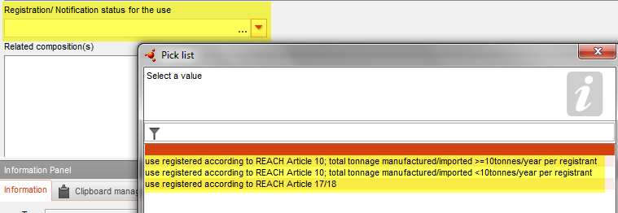
Document format
Section 3
Structure implemented
The new version of the use and exposure information section is planned to incorporate a conditional formatting based on the type of use reported. This conditional formatting is not yet available and all fields (for all conditions) are currently displayed.

Slide 11
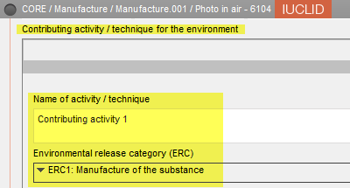
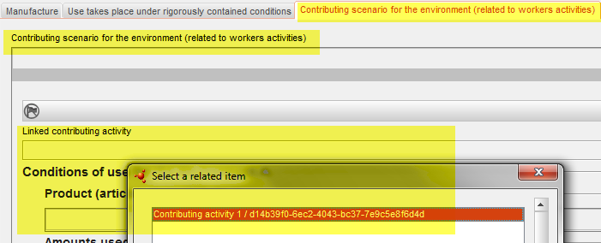
Document format
Section 3
Link between Contributing activities and Contributing scenarios

Slide 12
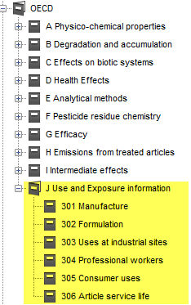
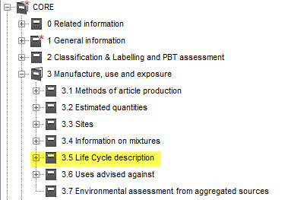
Document format
Section 3
Structure implemented
Conditional formatting is missing
Data not synchronised with the OECD templates, for REACH purposes, the CORE documents should be filled in and this is also where the migration is done

Slide 13
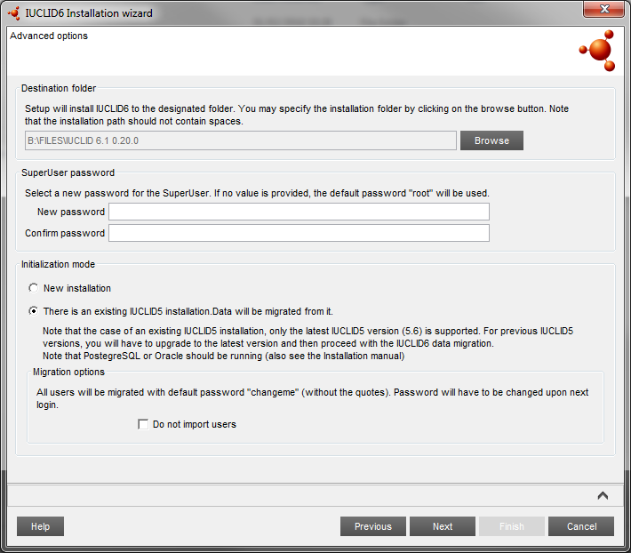
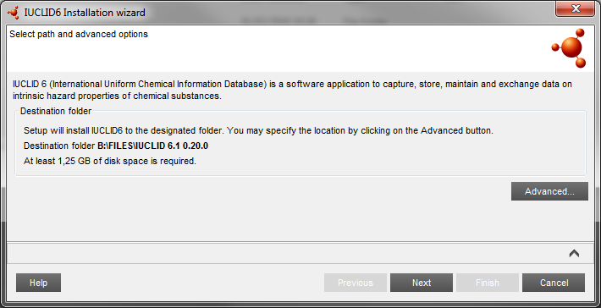
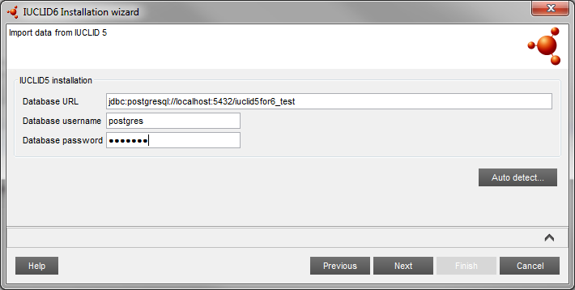
Migration
How to run the migration?
Desktop version: included in the installer
Server version: instructions in the installation manual

Slide 14
Migration
Migration rules and report
Migration rules are documented and main rules are made available to the testers
Migration report
Newly structured to facilitate screening the report using Excel
All rules are logged but some are warnings and can be safely ignored, for example:
MR6112: Migration of test material information, test material created in the inventory
MR0032: Literature reference was created with default values

Slide 15
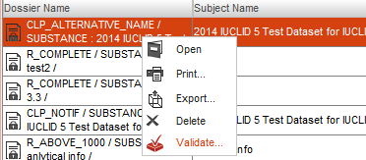
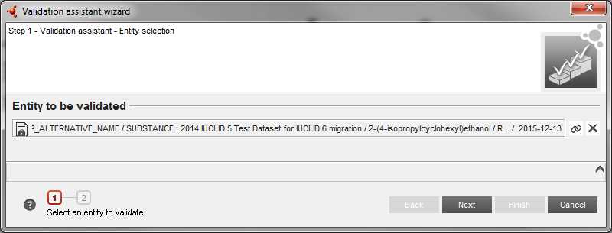
Validation assistant

Slide 16
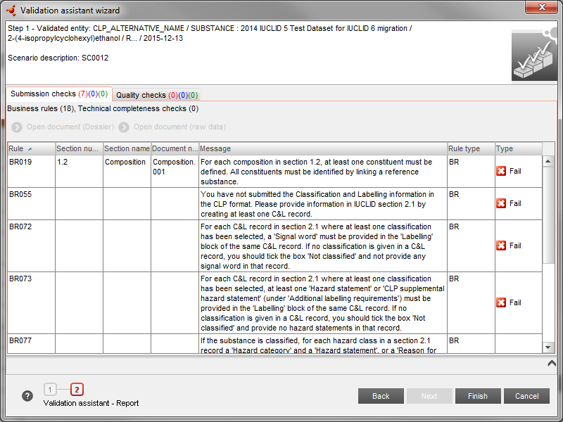
Validation assistant

Slide 17
Validation assistant
A preliminary version of the Validation assistant plug-in is available and can be used for testing purposes
Completeness Check
All foreseen Validation assistant completeness check (TCC) rules are available (manual verification checks performed by ECHA are not be predicted by the Validation assistant)
Business rules
Business rules (BR) replicating REACH-IT behaviour are implemented (those only relying on IUCLID data)
Additional business rules performed on REACH-IT data will be included in the Validation assistant to the extent possible, e.g. verification of the previous submission number format
Quality rules will not be available for the official release
This preliminary Validation assistant version can be used to get familiar with the revised rules, as well as to identify already in advance where information may need to be updated (before or after migration). It cannot be used to predict the final outcome of the submission to ECHA.

Slide 18
Work in progress
The following elements are still planned to be implemented for the official release
Plug-ins
Dissemination viewer
Report generator (CSR, SPC)
Fee calculation
Help System (for IUCLID documents and Data Submission Manuals)
Backup and restore
Bulk operations on datasets (delete, share)
Conditional formatting (e.g. for use and exposure information in section 3)
Improved user interface (as discussed at OECD meeting)
Hyperlinks
Installers for Mac and Linux

Slide 19
Test versions available on the IUCLID 6 website
Installation packages:
64-bit versions (32-bit version available on demand to the ECHA Helpdesk)
Installer for the Desktop version (migration tool embedded)
Server version and migration tools
Update of installation manual (system requirements)

Slide 20
Good to know before starting the migration from IUCLID 5.6 to IUCLID 6

Slide 21
IUCLID 5 issues
Two IUCLID 5 database tools are available (test version)
For advanced users, two tools are made available to fix potential issues with the IUCLID 5 database
Attachment corrector tool
Identification of corrupted attachments (scan mode)
Fix of the corrupted attachments by relinking the documents when possible or by attaching a default file (fix mode)
In all cases the changes are logged and manual fixes can be done is needed (user actions needed for raw data are listed in a separate report produced by the tool)
Broken / invalid references identifier
Only identifies issues for the time being
They should be run on a copy of the IUCLID 5 database and before launching the IUCLID 6 migration

Slide 22
Feedback and issues reporting

Slide 23
List of bugs and pending improvements
Excel list of pending issues is provided to the testers
Example of issues detected so far
Viscosity value not migrated
Section 1.4: analysis type not migrated corrected in all cases
Help system print does not work in some cases

Slide 24
Test phase 6
Reporting
To the ECHA Helpdesk
Testers registered to the previous phase can use JIRA for issues reporting and documentation (no new JIRA accounts are created)
iuclid6@echa.europa.eu
Timeline
5 February: test version for phase 6 (IUCLID 6 version 0.20)
Please report your findings as soon as possible by 11 March
At the end of the testing period we will invite the users who downloaded the test version to answer a short survey

Slide 25
Format changes
IUCLID 6

Slide 26
New data format
Substance identity information
Section 1.1 Substance
‘Other identifiers’ table to capture identifiers used previously, or in other regulatory contexts
Section 1.2 Composition
New field to describe the purpose of the composition (e.g. boundary compositions - SIP, LE specific composition)
Description for complex substances (UVCB)
State / form moved from section 2.1 to section 1.2
Nanomaterials parameters
Section 1.4 Analytical information
Can be linked to compositions
Analytical methods and results of analysis are combined in a table format

Slide 27
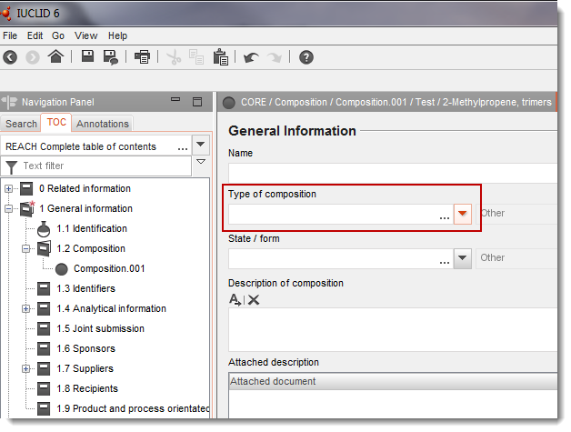
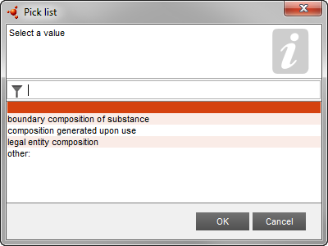
Substance identification profile (SIP)
Specified in the composition section (1.2) in IUCLID
The collectively agreed boundaries of the substance in scope of a registration/notification/application
The ‘glue’ between registrant-specific compositions and the jointly provided hazard data, C&L
Registrant 1 composition
Registrant 2 composition
Boundaries:
Concentrations
Impurities, additives with C&L impact
Forms
Data package:
Hazard information
Hazard assessment
C&L
Registrant 3 composition
Registrant 4 composition
Registrant 5 composition

Slide 28
IUCLID 6 format changes
Section 2.1
One record per C&L
Update to ATP 8 (GHS version 5)
New hazard category
Update to GHS version 6, published in 2015
New hazard class
Form of the substance moved to composition
Reason for (no) classifications moved from the endpoint summaries to section 2.1

Slide 29
IUCLID 6 format changes
Section 3
Section 3.1 removed / migrated
Section 3.2 minor changes
Section 3.5 and 3.7: use and exposure information
Several records can be created per use, per life cycle stage
each use is described through a name; the contributing activities, which are defined through the CA name and the appropriate descriptors depending on the activity (ERC, PROC, PC, AC); and additional descriptors to provide market information (SU, TF…)
New fields created, e.g.:
Regulatory status for the use (cosmetic, intermediate)
EU tonnage
Differentiation per use type: art. 10, 17/18, 38
Dedicated fields to report use as intermediate and rigorous containment / strict control
OECD / REACH information
Majority of the use information has been moved to an OECD template
Specific REACH fields are kept in a separate document (that links to the OHT)
REACH view will be built for filling-in the information but the data will be stored in separate records

Slide 30
IUCLID 6 format changes
Section 3: use and exposure information
Harmonisation at the OECD level and update of the format to support specific ECHA needs lead to the (technical) split of the format
As part of the IUCLID simplification, we are working on a combined view to manage use and exposure information in IUCLID 6 for REACH purposes:
Combining OECD and REACH information
Combining use and exposure information
Customising the entry screens depending on the type of use
Article 10, <10 tpa
Article 10, >10 tpa
Article 17 / 18 (intermediate use): e.g. SCC-intermediate use does not need the exposure scenario part
Article 38 (DU report)

Slide 31
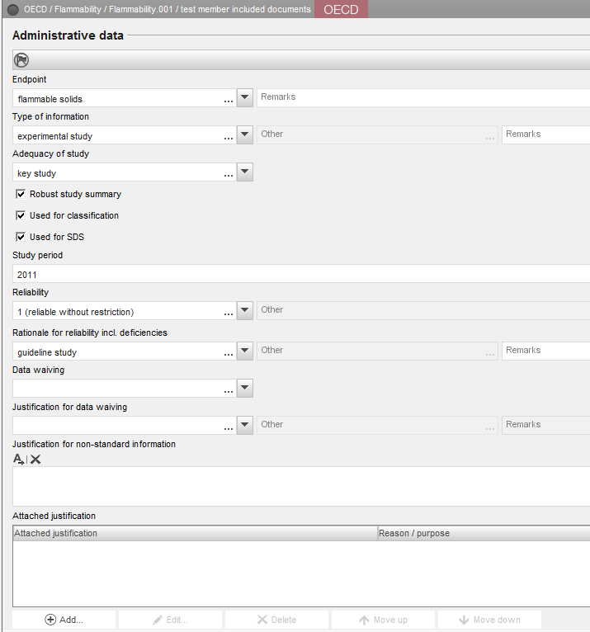
IUCLID 6 format changes
Sections 4 to 7
Generic changes to all OECD Harmonised Templates
Administrative data (endpoint field to precise the information requirement, data waiving and justification picklists…)

Slide 32
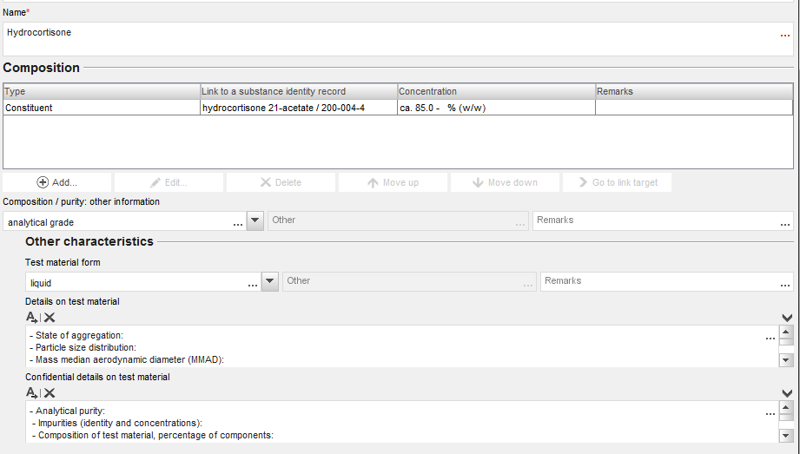
IUCLID 6 format changes
Sections 4 to 7
Generic changes to all OECD Harmonised Templates
Test material information is now a separate object in IUCLID

Slide 33
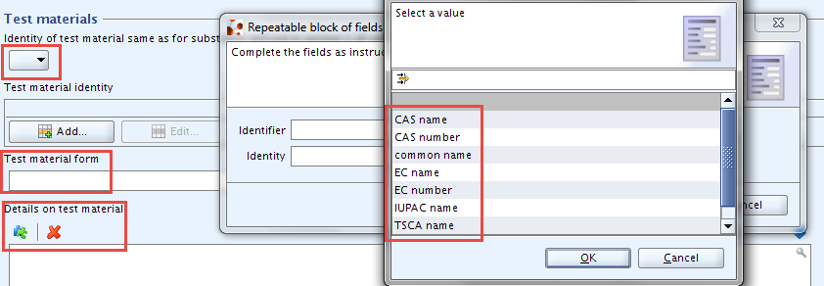
IUCLID 6 format changes
Test Material Information – Migration rules (example)
TMI created as soon as test material information is available in IUCLID 5 (to avoid creation of duplicates, UUID are generated based on data)
Identity of test material same as for substance defined in section 1 (if not read-across) {TestMaterials.Indicator}
Test material identity and identifiers
{TestMaterials.Indicator} = Yes: information is retrieved from section 1.1 or 1.2
EC number, CAS number, EC name and IUPAC names are mapped to existing reference substances or a new one is created

Slide 34
IUCLID 6 format changes
Sections 4 to 7
New OECD Harmonised Templates
#23-2: Self-reactive substances
#23-3: Organic peroxide
#23-4: Corrosive to metals
#23-5: Gases under pressure
#48-2: Endocrine disrupter testing in aquatic vertebrates – In vivo
#75-3: Endocrine disruptor mammalian screening - In vivo (level 3)
#201: Intermediate effects
(13 existing nanomaterial templates will be added to the registration dossiers too)
New REACH records
Annex III checklist
Downstream user report

Slide 35
IUCLID 6 format changes
Sections 4 to 7
Update of the endpoint summaries
Endpoint summaries are now available for all endpoints
Link to relevant endpoint study records
Reason for (no) classification moved to section 2.1

Slide 36
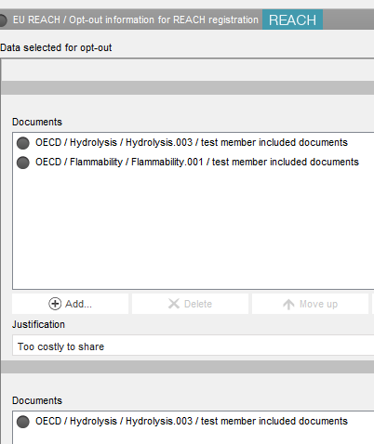
IUCLID 6 format changes
Dossier creation
Opt-out information moved to the dataset
New picklist element for specifying a tonnage band 1-10 t/y (phys. chem. requirements)
New spontaneous update reasons

Slide 37
IUCLID 6 features

Slide 38
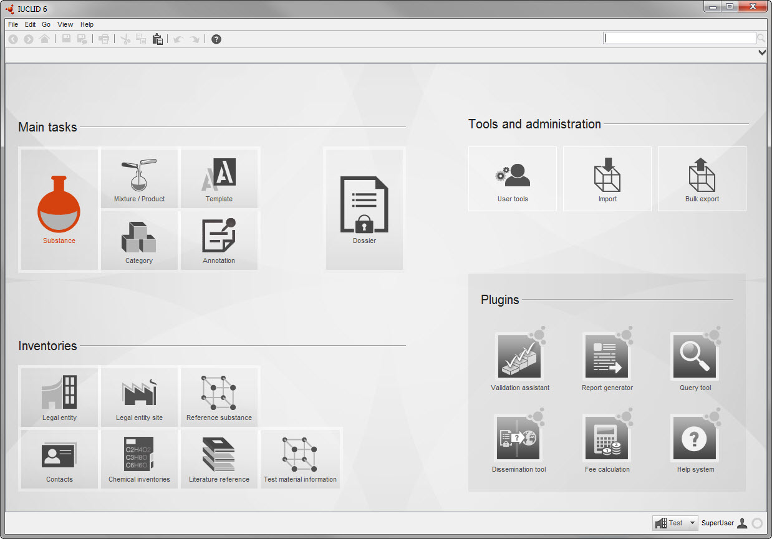
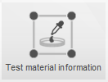
Modernised interface
New technological platform
Advanced security
New format
IUCLID 6
IUCLID format update (OHTs, use and exposure, etc.)
Simplification of user interface and key functions
Plug-ins redeveloped
Annotation inventory
Test material inventory
New help system

Slide 39
IUCLID 6 new features
Test Material Inventory
Test material information centrally managed in an inventory
Link is made from the Endpoint Study Records

Slide 40
IUCLID 6 new features
IUCLID 6 supports more transparent data organisation for “complex cases”
If one substance needs multiple datasets for the assessment:
(group of) constituents behaving differently from each other
substance transforming during use or in the environment
different compositions (or forms) with different hazard-profile
“Assessment entity” in IUCLID 6 enables
to group substance property data-sets for the assessment
to clearly explain the assessment approach and to improve understandability of disseminated information
opportunities for the assessor to make his case more transparent (non mandatory)

Slide 41
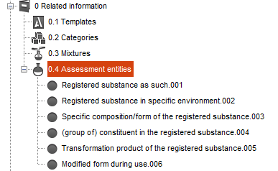
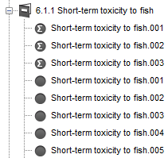
IUCLID 6 new features
Assessment Entity
The Assessment Entity concept is introduced in IUCLID 6 to describe the assessment approach more transparently when needed
Assessment Entities are defined under section 0.4
They can be linked to relevant data (via endpoint summaries)

Slide 42
IUCLID 6 features
Overview of the functions already available
IUCLID entities management (substance, mixture, legal entity…)
Dossier creation
Basic search
Import / export
Migration of i5z files
Main engines for:
Filtering
Printing
Validation
Annotations
Information panels
Attachments
Secured client / server communication
User management
Instance-based user permissions
Help system
Desktop version installer
Clipboard manager

Slide 43
IUCLID 6 features
Features abandoned
Light dossiers
Folders

Slide 44
End of presentation

